Slide 2
Sketch Board
A Simple tool to paint your creativity
Notes:
TITLE PAGE (ALT)
Footer is only editable feature.

Slide 3
CONTENTS
Introduction
Problem Statement
Demonstration
Notes:
TITLE PAGE (ALT)
Footer is only editable feature.

Slide 4
INTRODUCTION
‘Sketch Board’ is a simple drawing application build for android platform.
This app provides a ‘ToolKit’ which has various tools. Using those you can draw
a beautiful drawing.

Slide 5
Problem Statement
Develop an paint application for Android phones with following features:
Should be able to draw the basic shapes like rectangle, circle, ellipse etc.
Should be able to do a normal pencil drawing by selecting the different width and
color selection.
Erasing elements which are already drawn.
Should be able to insert text within the drawing.
Select color and fill elements with that color.
Image should be saved locally in the device. If possible all the details of the image
like creation date, thumbnail data, name etc.

Slide 6
Good To Have Features:
User should be able to rotate, resize the image saved.
Please check for some server, where we can upload the images. We should write our
code for doing the HTTP communication and uploading the image to the server)

Slide 7


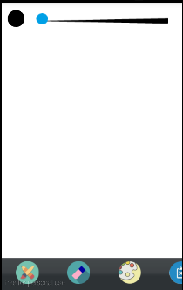










A look at the Application
Pencil
Un do
Color Indicator
Eraser
Circle
Stroke Adjustment Bar
Color Pallet
Square
Clear Canvas
Oval
Text Box
Open from Gallery
Tool Kit
Save to Gallery
Upload to Server

Slide 8
Thank You
Thank you

